Slide 1

Potential Energy I
Adopted from MIT Course
FISIKA DASAR 1

Slide 2

two “types” of Potential energy:
Gravitational Energy is caused by the force of gravity pulling down on an object while the object is being held up!
Elastic Energy is caused by changing the shape of an object (stretching, bending, pulling, squishing)
Adopted from MIT Course
2

Slide 3
I. Gravitational Potential Energy
In general, this is another form of real energy.
Potential energy is associated with the position of the object.
Since the force of gravity is down. We only worry about the vertical distance.
Potential Energy is not absolute. It is a vertical difference.
The path the object takes doesn’t matter, just the endpoint and startpoint distance.
height is measured from any chosen point.
Adopted from MIT Course
3

Slide 4
What does Potential Energy depend on and how does it affect potential energy?
Potential energy depends on both of mass and height.
Height – The higher the object, the more potential energy.
Mass – The greater the mass of the object, the more potential energy it has.
Adopted from MIT Course
4

Slide 5
Gravitational potential energy (PE) is the energy stored in an object as a result of its height.
PE can be calculated using weight, which is mass times gravity, and height.
PE is given by the following equation,
PE = m g h
Adopted from MIT Course

Slide 6

Examples of Gravitational Potential Energy
Water at the top of a waterfall
Yo-Yo in held in your hand
Books on a shelf
A man and his cell phone are on a ledge outside a very tall building.
Adopted from MIT Course
6

Slide 7

II. Elastic Potential Energy
Compressed, or squished, springs also have potential energy.
A spring has energy because work has been done to change its shape.
Adopted from MIT Course

Slide 8
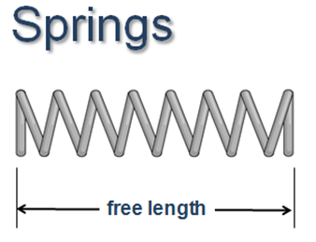
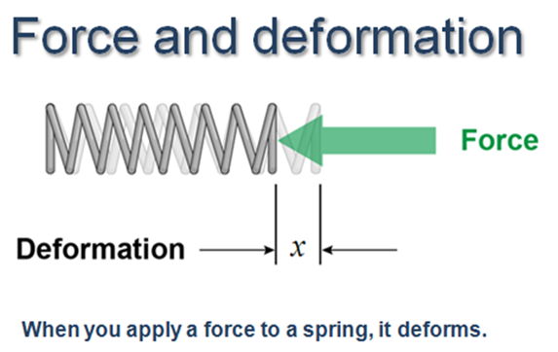
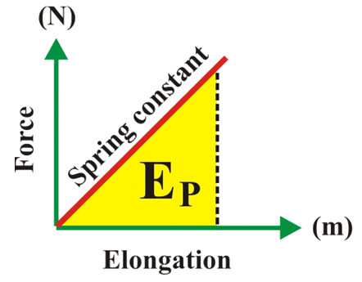
Spring Force
k
When the spring force (F_{S}) is plotted versus the elongation (x) of the spring, the resulting graph is a linear relation.
The slope of the curve represents the spring constant while the area under the curve represents the potential energy stored in the spring.
Adopted from MIT Course
Notes:
This initial portion on springs should be considered a review from the Hooke’s law lesson in an earlier chapter on forces and Newton’s laws. Students should have prior exposure to the “equilibrium length” or “free length” for a spring from an earlier chapter on force and Newton’s laws.

Slide 9
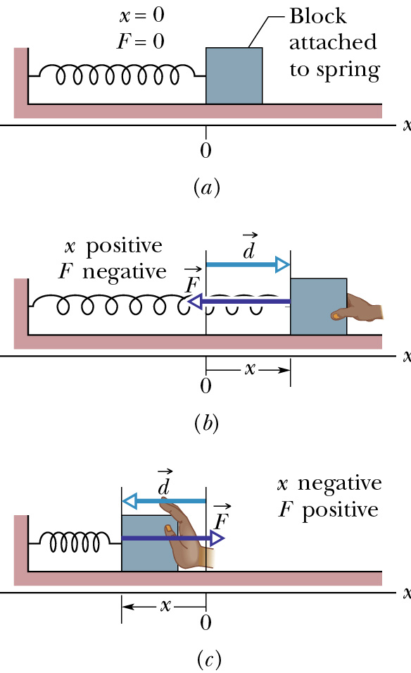
Hooke’s Law gives the force
F = -k (x-x_{o})
F is in the opposite direction of displacement d, always back towards the equilibrium point.
Adopted from MIT Course
9

Slide 10
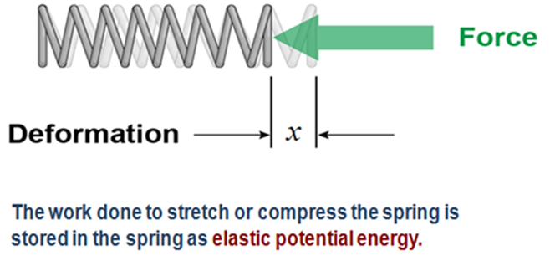
Potential Energy in a Spring
Elastic Potential Energy: PE = ½ k x²
Work done by the spring: W = ∆PE = PE_{f} - PE_{i}
Adopted from MIT Course

Slide 11
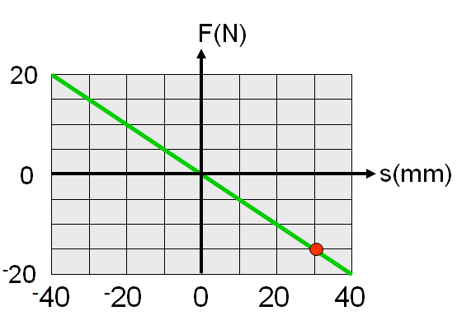
Example 1
e
A force vs displacement plot for a spring is shown. Find the value of the spring constant, and find the spring force if the displacement is -65 mm.
Solution
Pick any convenient point. For this point F = -15 N and s = 30 mm
F = -k s
-15 = -k (0.03)
k = 500 N m⁻¹
F = -k s
= -(500) (-65×10⁻³)
= 32.5 N

Slide 12
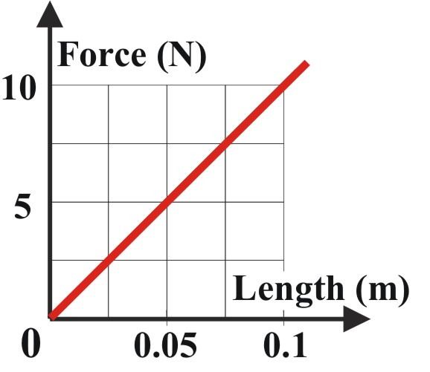


Example 2
The graph represents the force-compression graph of an ideal spring. Determine the spring constant and calculate potential energy of an object that collides with this spring and compresses it a distance of 0.6 m.
Solution
The spring constant (k) is 100 N/m

Slide 13



Example 3
e
A block of unknown mass moves at 2 m/s towards a horizontal spring whose spring constant is 1000 N/m. If the spring is compressed a maximum distance of 0.4 m, what is the mass of the block?
Solution
Since there is no mention of friction, we assume system is frictionless.
At maximum compression, PE = initial KE of mass

